Slide 1
The Comprehensive Patient History
Marissa Drake, CNP, DNP, FNP​​​
Community Faculty​​​
College of Nursing and Health Sciences​​​
Metropolitan State University​​​
St. Paul, MN

Slide 2
Agenda
New v. established patient
Comprehensive health history
Allergies
Medications
Past medical history
Past surgical history
OB/GYN history
Psychiatric history
Family history
Social history
Health maintenance

Slide 3
New v. established patient
New patient – comprehensive health history
ROI for prior records- clinic staff may collect these ahead of time
Care everywhere (epic)
Established patient- updating information from last visit
Let your EHR be your guide

Slide 4
Allergies
Medication- include what the reaction was
Food
environmental

Slide 5
Medications
Prescription, OTC, supplements
Include dose, route, frequency

Slide 6
Past medical history
Look at medications, ask what they take them for
Consider dividing up by body system, don’t use medical terms, adjust based on age
Cardiac (heart disease, high blood pressure, high cholesterol)
Respiratory (asthma, COPD)
Endocrine (diabetes, thyroid disease)
Autoimmune (RA, connective tissue disorders)
Cancer
GI (IBD, celiac, IBS)
Mental health (depression, anxiety, ADHD, substance abuse)
MSK (OA, osteoporosis)
Neurological (stroke, dementia)
Renal (CKD, kidney stones)
History of hospitalizations/ER visits?

Slide 7
Past Surgical history
Dates and names of surgeries
Ask about common ones
Wisdom teeth
Tonsillectomy
Cholecystectomy
Hysterectomy/oophorectomy
Joint replacement
Appendectomy

Slide 8
OB/GYN History
GTPAL
Gravida- number of times a woman has been pregnant
Term births (37+ weeks)
Preterm births (<37 weeks)
Abortions (losses < 20 weeks)
Living children
Gravida/Para
Gravida- number of pregnancies
Para- number of live births
G4 T2 P1 A1 L3
4 pregnancies, 2 were past 37 weeks gestation, 1 preterm, 1 lost before 20 weeks, 3 living children
G2 P1
2 pregnancies, 1 live birth
Could currently be pregnant, or could have had a pregnancy loss

Slide 9
Psychiatric History
Indications
extensive mental health history
starting treatment for a mental health condition
components
Diagnosed conditions, tried treatments
Psychiatric hospitalizations
Suicide attempts
Substance abuse
Psychiatry, psychology, crisis treatment

Slide 10
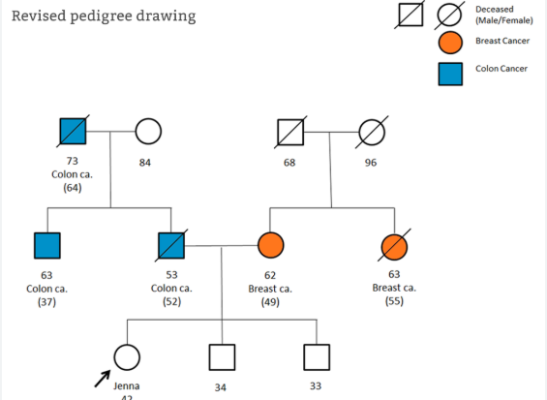
Family History
Parents, siblings, grandparents, children
Significant chronic conditions, living or deceased
Pertinent negatives as related to your visit
No family history of heart disease
Family pedigree → genetic counselor

Slide 11
Social History
What you obtain will depend on the visit
You will continue to build this narrative over your relationship with the patient
Weight loss → exercise, sleep nutrition
Depression → self care habits, support system, spirituality, substance use
STI screening → detailed sexual history
Sexual orientation and gender identity
Significant relationships (partner, number of children)
Support system
Work history/occupation
Education
Lifestyle and activities of daily living
Nutrition
Exercise
Substance use
Safety measures
Spirituality
Sexual history

Slide 12
Health Maintenance
Vaccines, cancer screening, bone density screening, labs
Differs by age and chronic conditions
Example: 23yo female
HPV vaccine status, flu/COVID, pap smear, STI screen
68yo female
Pneumococcal vaccine status, shingles vaccine status, mammogram, colon cancer screening, lung cancer screening (if indicated), bone density scan, falls screen
Your EHR will likely have a health maintenance list with reminders and ordering prompts

Slide 13
Resources
Soriano, R. P. (2025). Lippincott Connect for Bates' Guide to Physical Examination and History Taking (14th ed.). Wolters Kluwer Health. https://lippincott-connect.vitalsource.com/books/9781975277208

